Slide 1
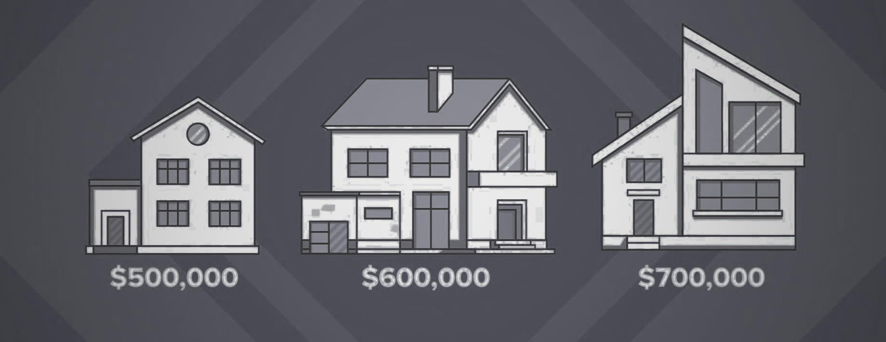
Online house appraisal APP
How much does A house worth?
Lu Han
07/28/2021

Slide 2
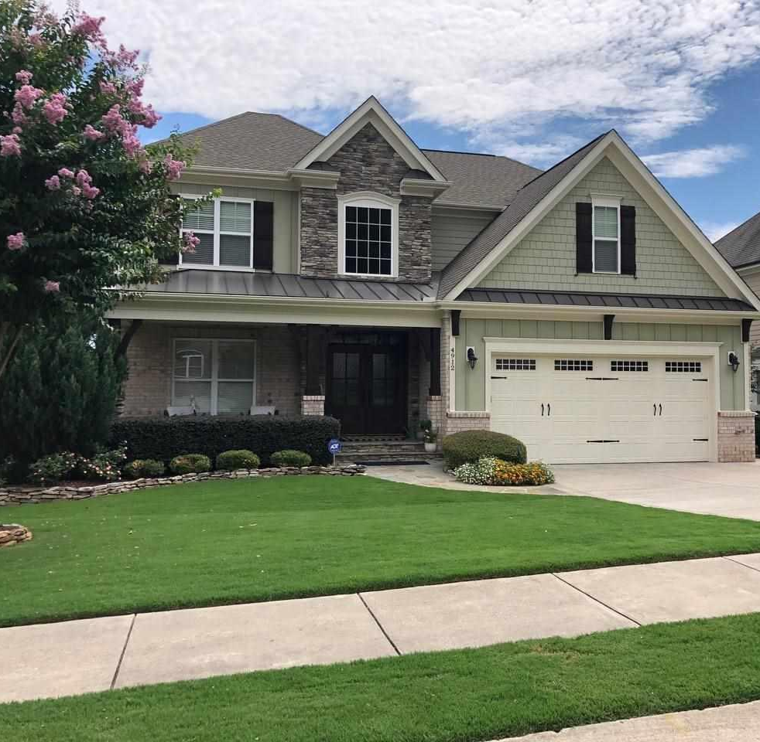


How Could You Find Out Your House Value?
4912 Great Meadows Ct, Raleigh, NC 27609
Listing Price: $875,000
Zestimate (Zillow): $880,000
Redfin Estimate: $853,140
Formal Appraisal: ???
Black Box!
Expensive!
To estimate the appraisal price,
we need to think as an appraiser!

Slide 3


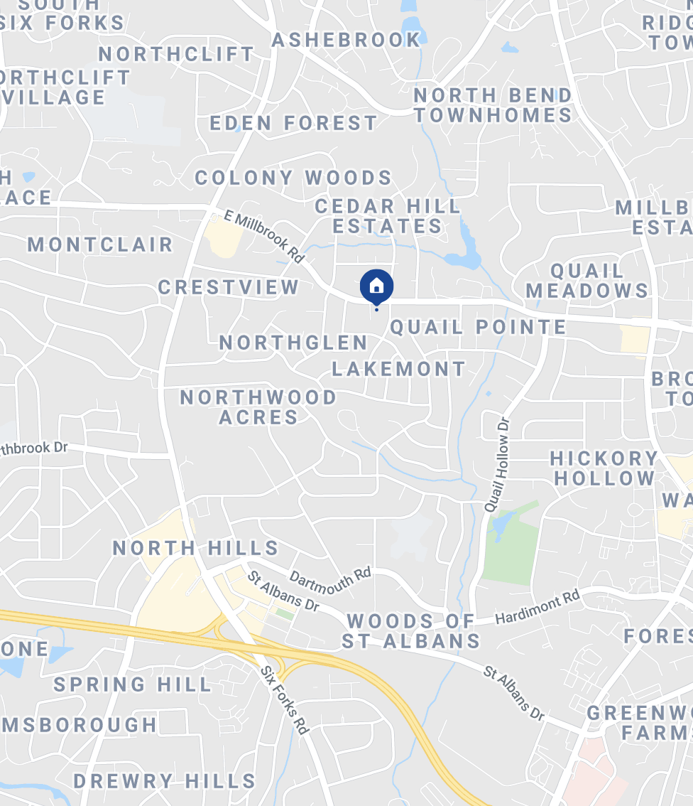

The Vision of MY Appraisal App
Your Address
 | Your Address | Comp #1 | Comp #2 | Comp #3 | …
Proximity to Subject |  | 0.15 miles | 0.75 miles | 056 miles
Sale Price |  | $ xx | $ xx | $ xx
Sale Price/Gross Liv. Area |  | $ xx | $ xx | $ xx
Date of Sale/Time | 07/28/2021 | 07/01/2021 | 06/28/2021 | 07/15/2021
Actual Age | 5 | 3 | 10 | 7
Bedroom # | 5 | 5 | 4 | 6
Bathroom # | 3 | 2.5 | 3 | 4
Gross Living Area | 3420 | 3405 | 3200 | 3570
Lot Area | 6400 | 6322 | 5608 | 7000
Fireplace | Y | N | Y | Y
Fence | Y | Y | N | Y
# of Comps
Search
Sold in the past # days
Make Adjustment to the Comps
The estimated value for Your Address is
$ 870,509

Slide 4

Progress
GetDeepSearchResults('4912 Great Meadows Ct.’,
city='Raleigh',state='NC',
zipcode=27609,
rentzestimate=TRUE,
api_key=getOption(‘ZillowR-zws_id'))
#retrieve the zpid from GetDeepSearchResults
zpidex <- GetDeepSearchResults(
‘4912 Great Meadows Ct.',
zipcode=27609,
api_key=getOption(‘ZillowR-zws_id')
#GetComps for the '4912 Great Meadows Ct.' address
GetComps(zpidex, count=10, rentzestimate=TRUE,
api_key = getOption(‘ZillowR-zws_id'))
GetZestimate(zpids= zpidex ,
api_key=getOption(‘ZillowR-zws_id’))
GetUpdatedPropertyDetails(zpid=2084934591 ,
api_key= getOption(‘ZillowR-
zws_id’))
Find comps under certain criterial using Zillow API.
Retrieve features of the comps and target house.
Build the app using Dash.

Slide 5
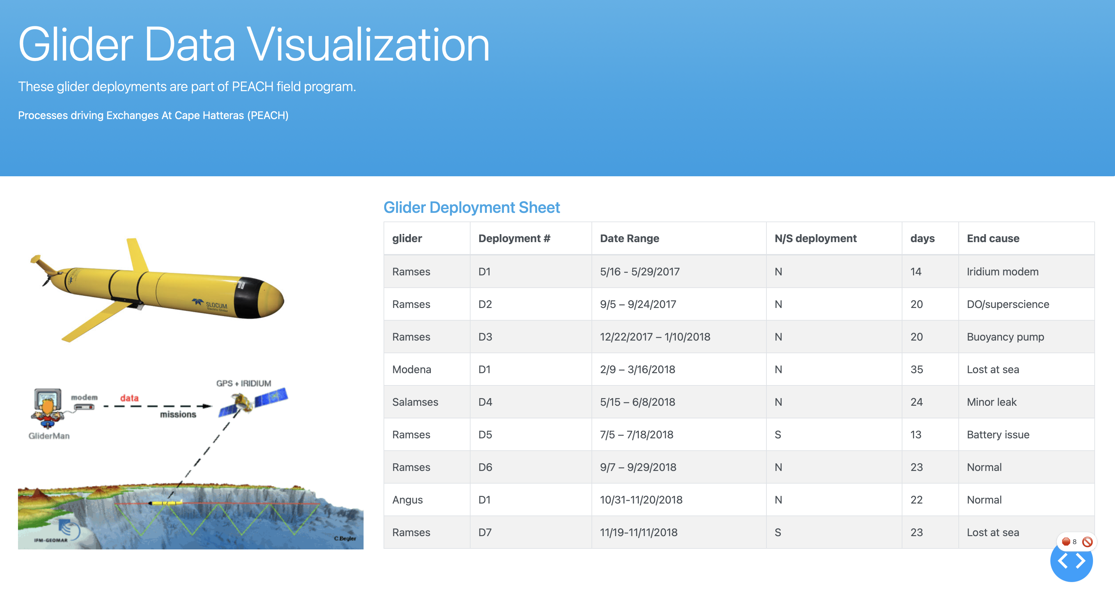

Slide 6
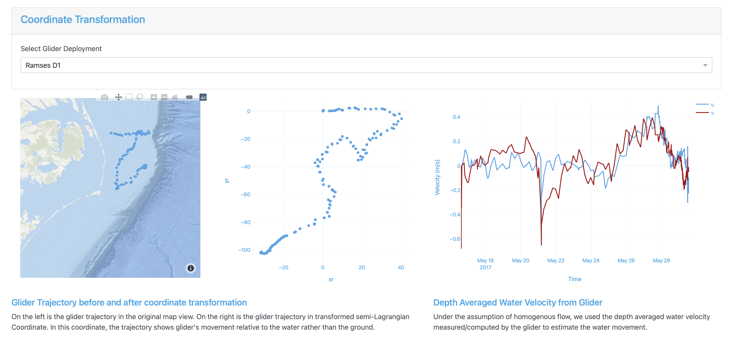

Slide 7
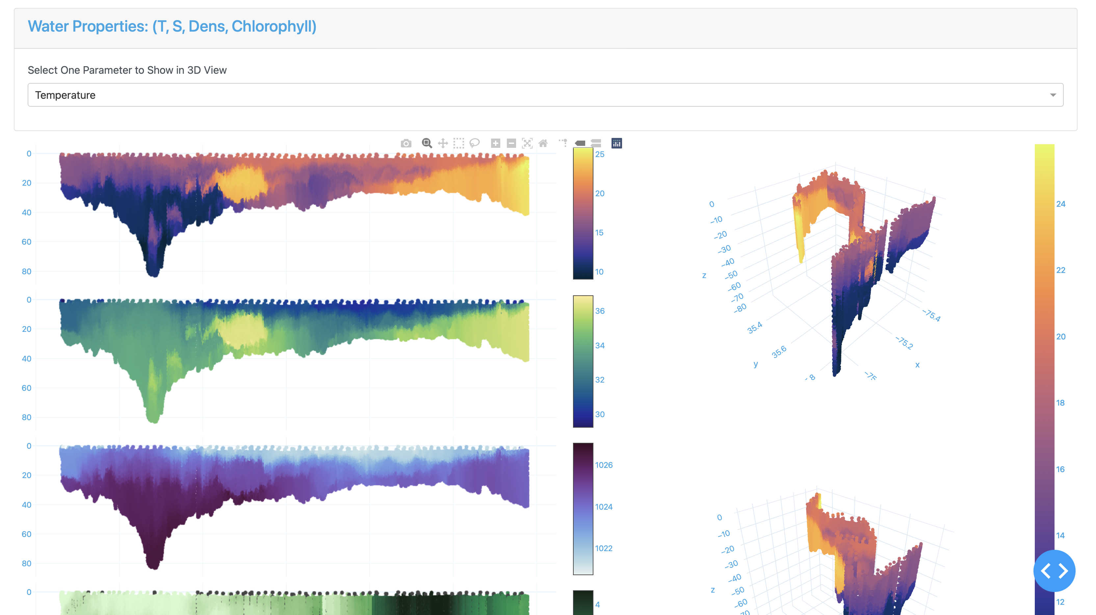

Slide 8
